Slide 1
Magnet experiment
Including the force and torque graphs and reasons why they are acting in that way

Slide 2
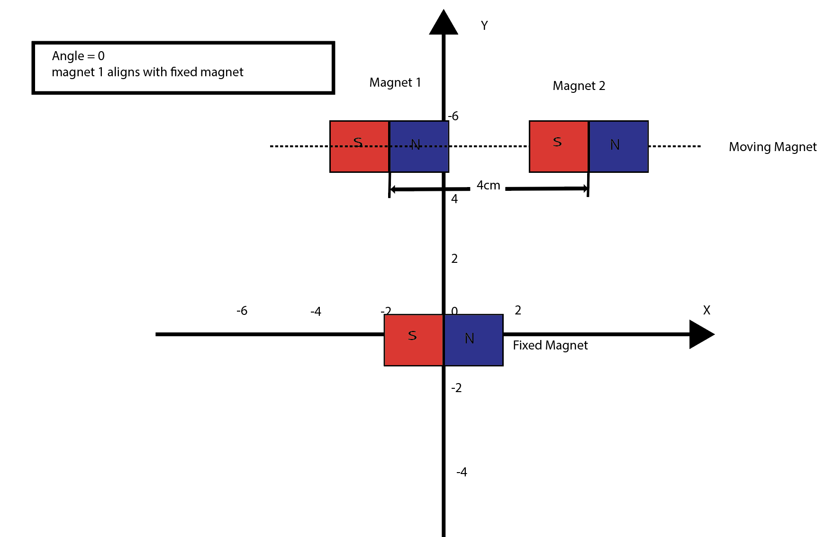
Angle = 0
All magnets are aligned with angle = 0.
Fixed magnet is placed at(0,0).
And the moving magnets are separated by 4cm from the center of each one moving from -8 to 8.

Slide 3
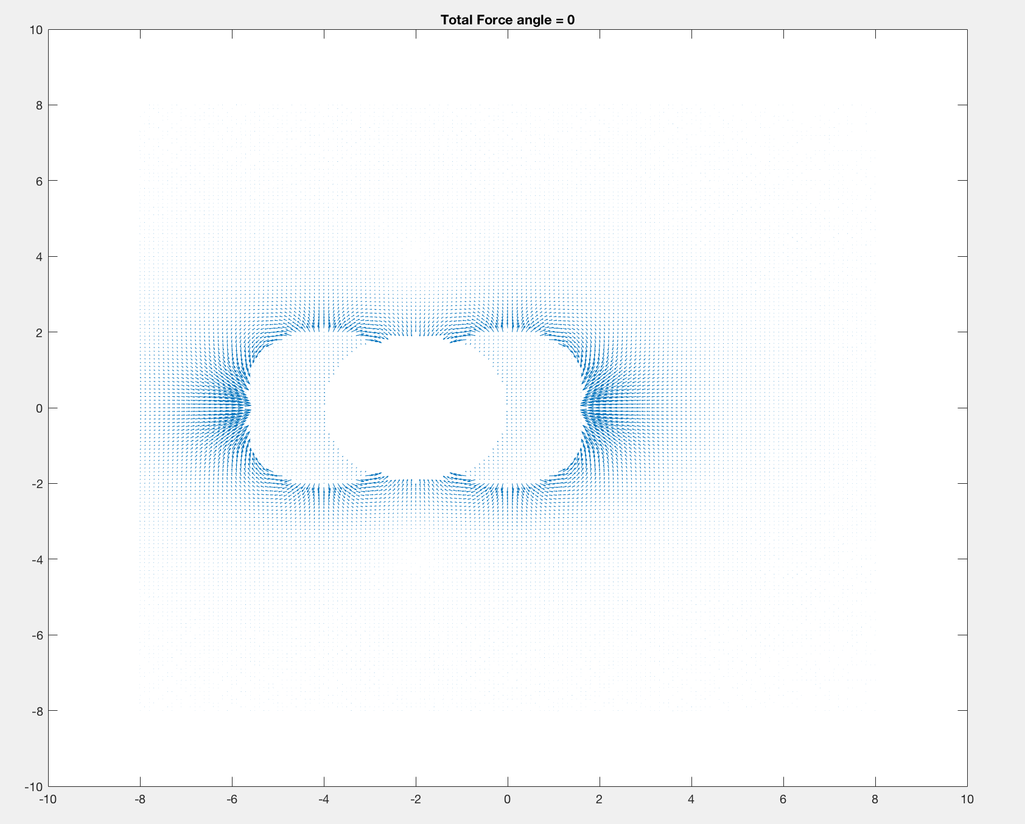
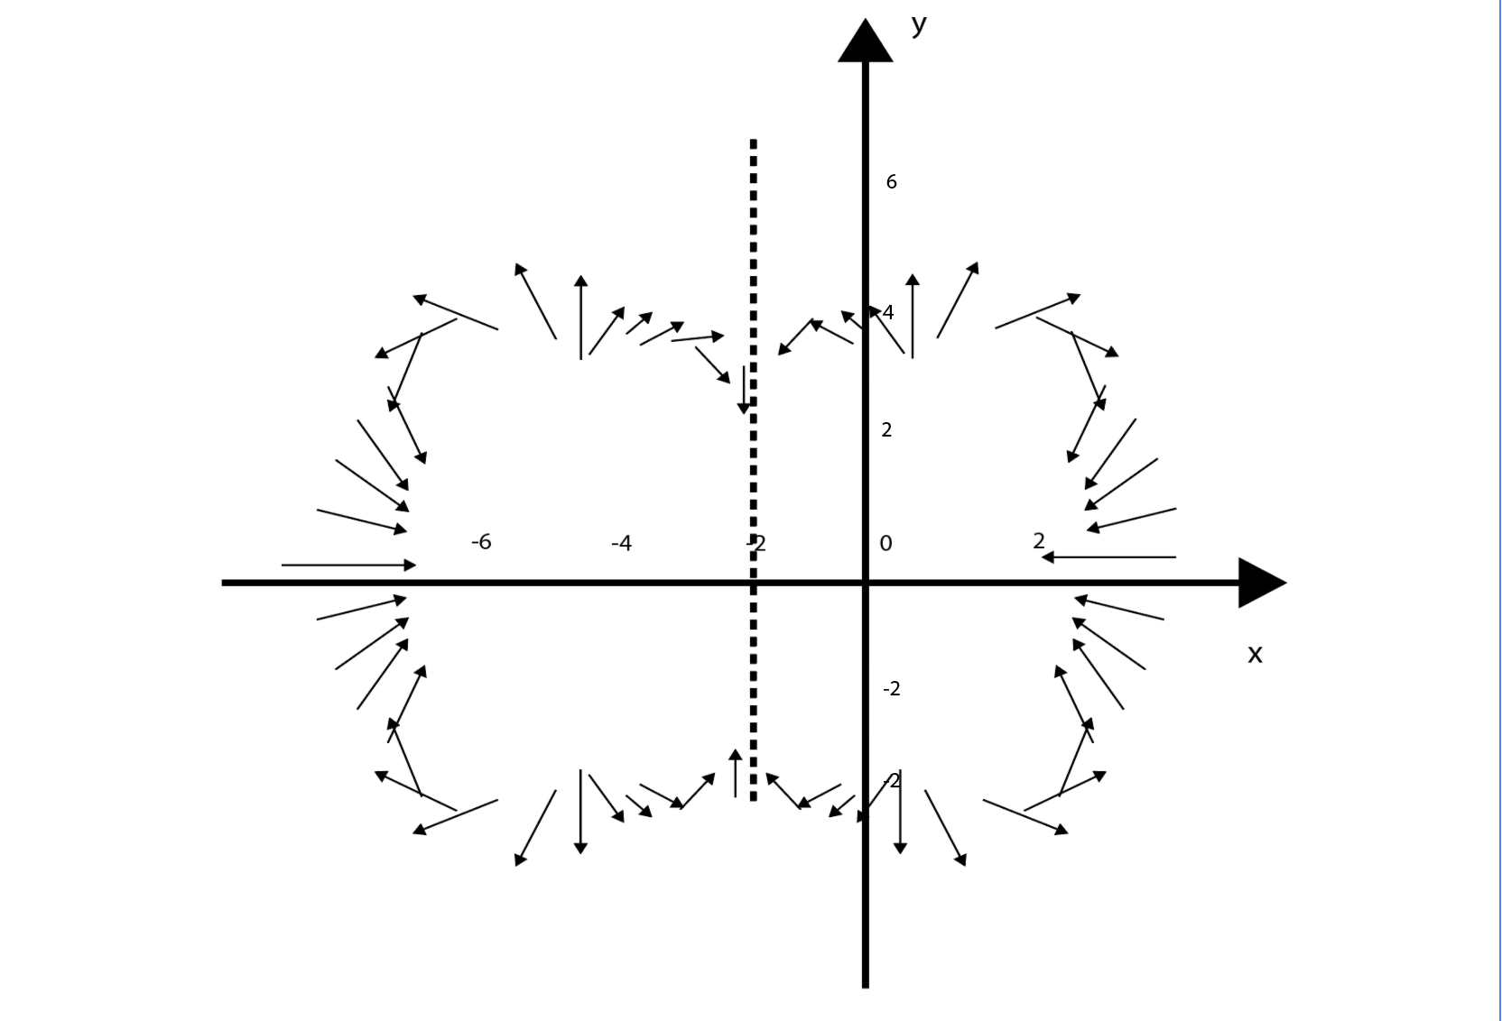
vector map for FORCE

Slide 4
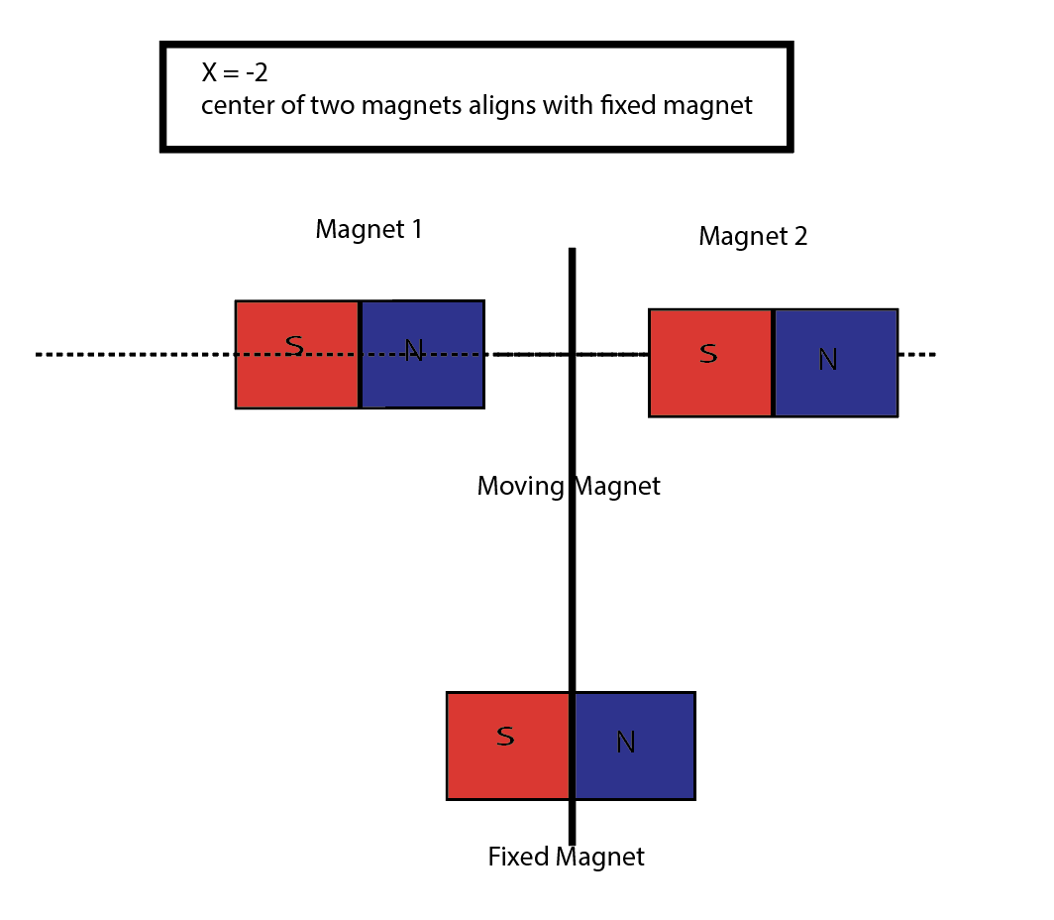
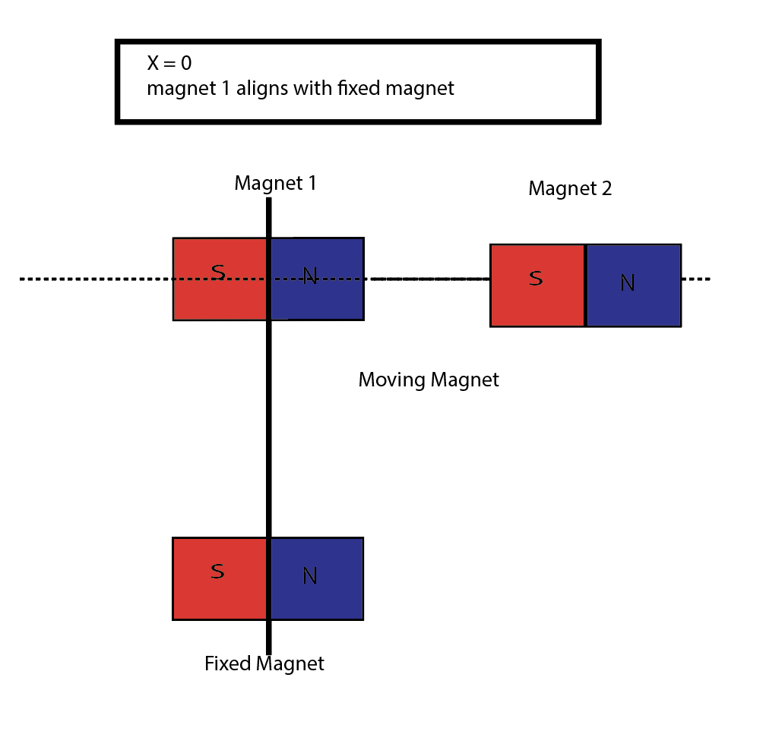
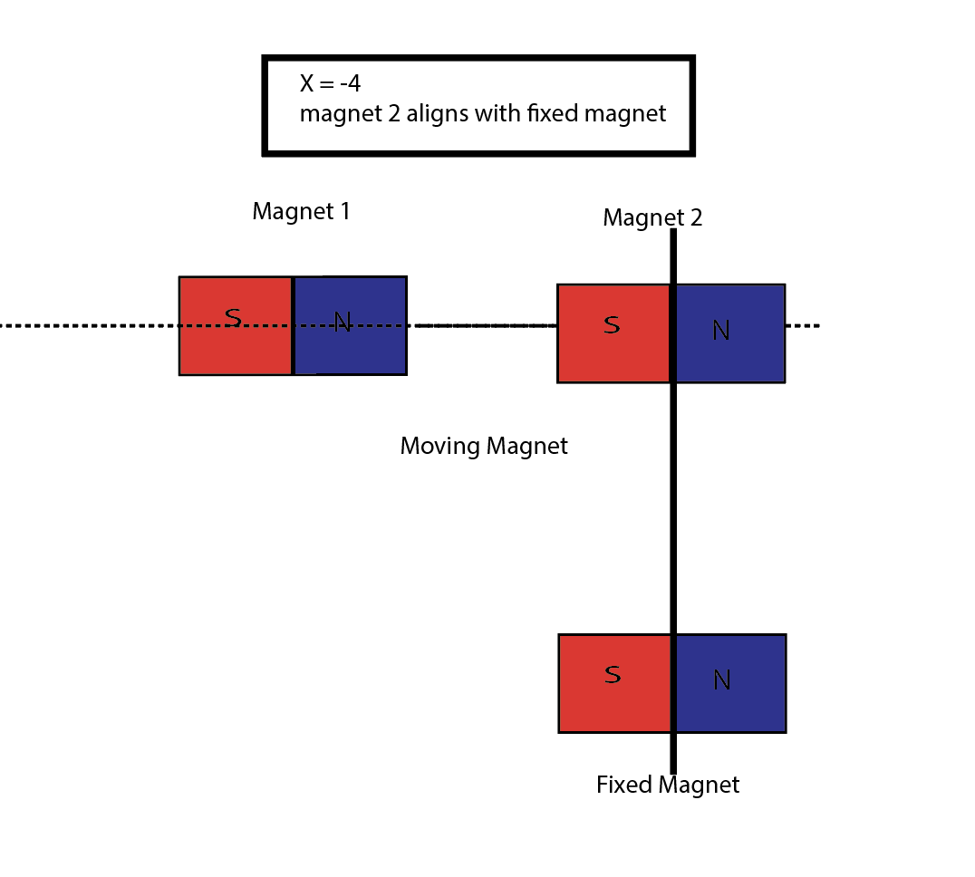
Critical points and Inflection Lines
（-6,-2) force points upwards positive torque
（-6,2) force points downwards positive torque
(-8,0) force points to the right zero torque
(8,0) force points to the left zero torque
(-3，-3) force points upwards negative torque
(3，-3)force points upwards negative torque
(-2,-2) force points downwards positive torque
(2,-2) force points downwards positive torque
From the graphs we can say that, there will be 3 lines at where the force changes direction and the torque changes sign. They are x = 0, x = -2 and x = -4.
Because at those lines, two magnets are aligned vertically, the force between them is expelling each other. However, when they are separated a little bit, the force will change to attraction rapidly.

Slide 5
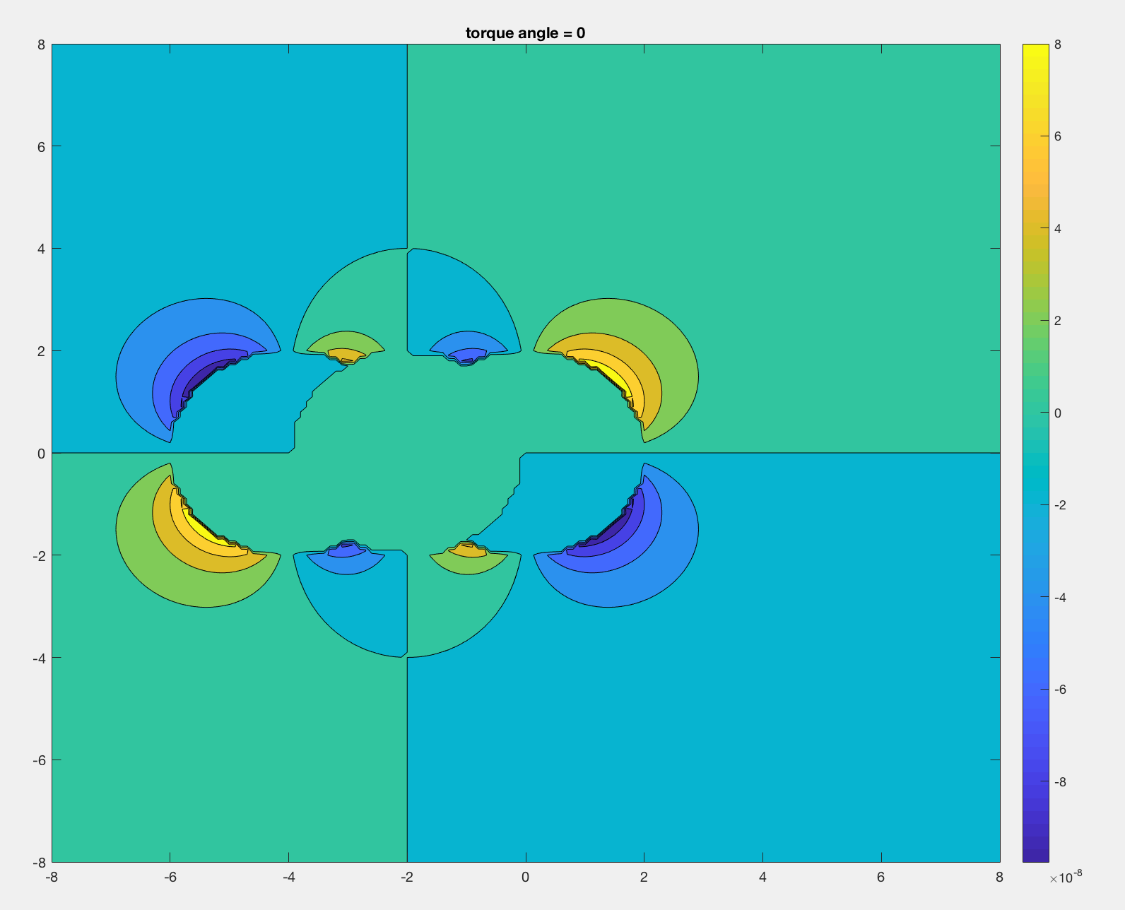
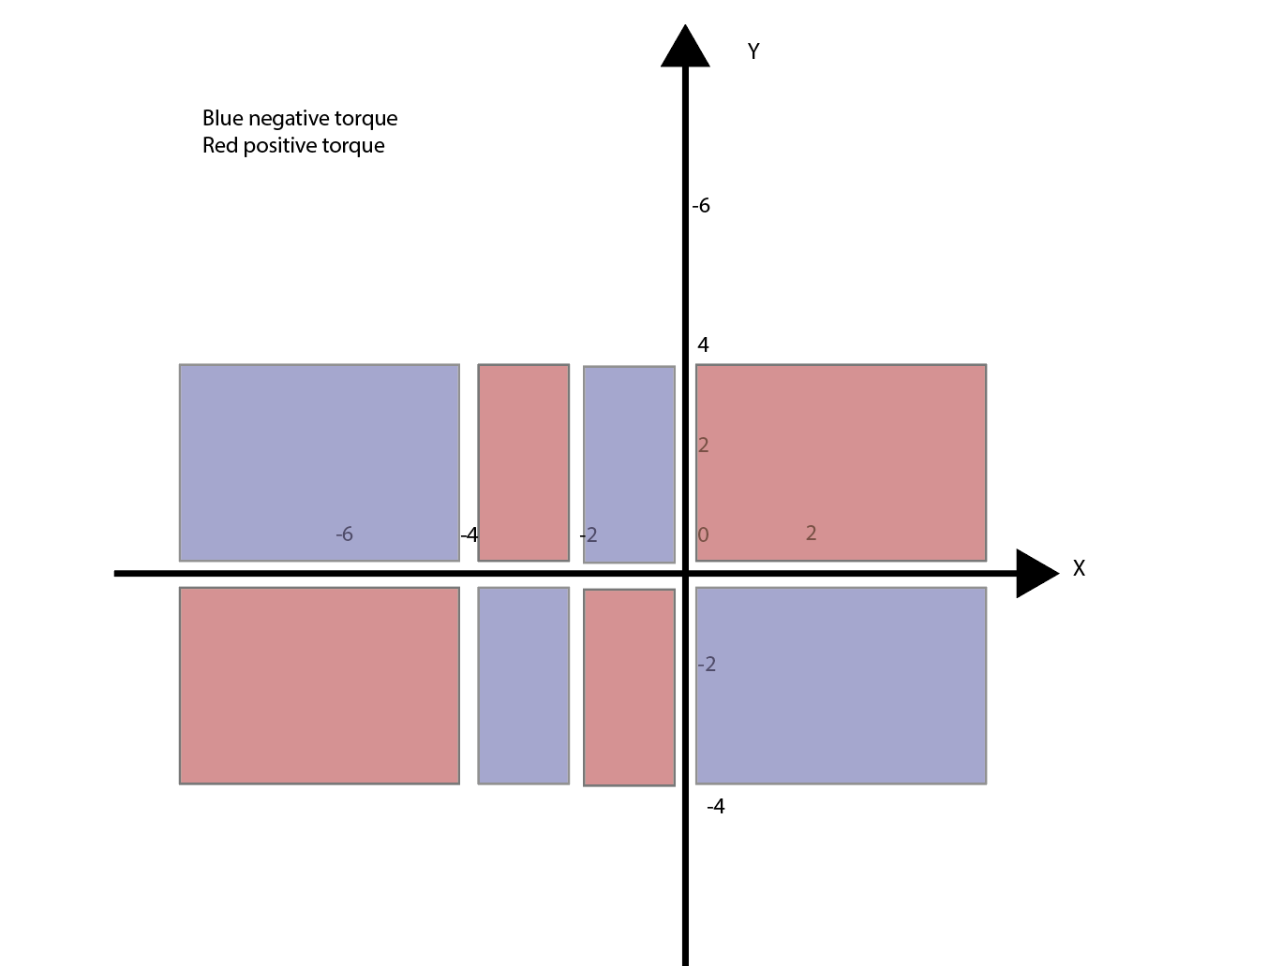
Torque graph
In the torque graph, the red and blue areas represent positive torque and negative torque respectively from where we can found they are symmetric with x-axis y-axis, line x = -4 and line x = -2.

Slide 6
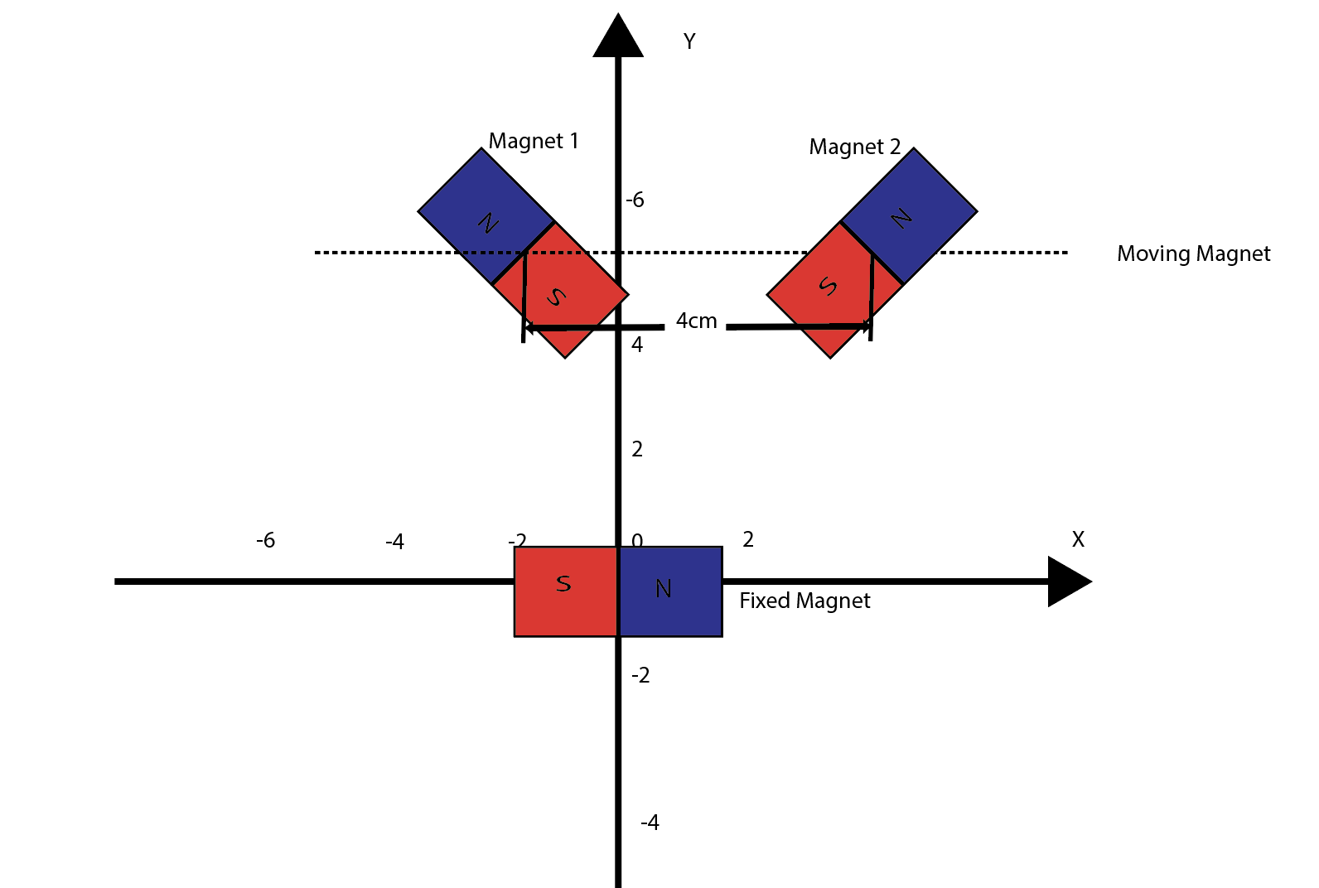
Angle = 45 and angle = 135
The angle of two moving magnets are 45 and 135 respectively.
The fixed magnet is placed at (0,0).
And the center of them are separated by 4cm

Slide 7
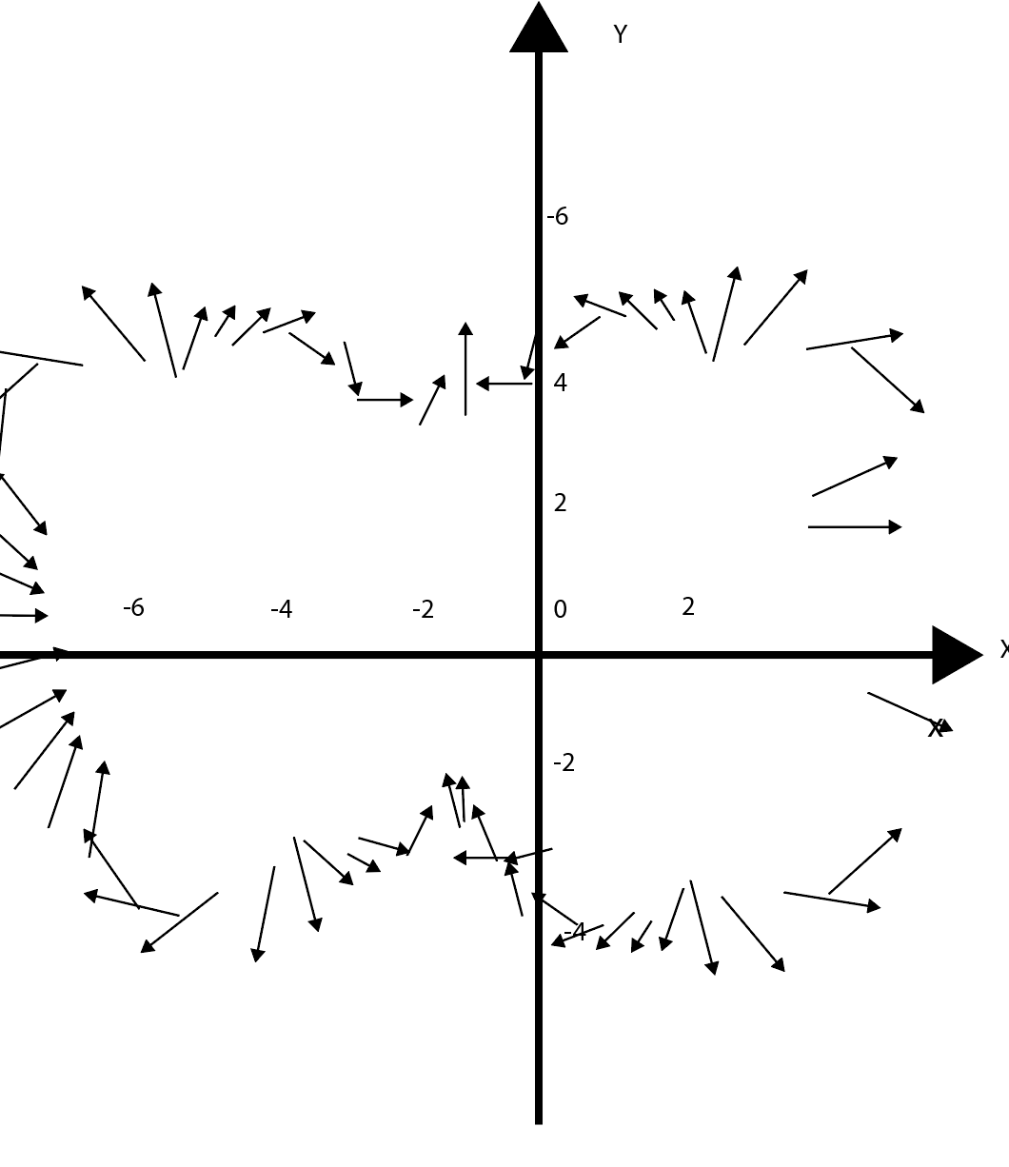
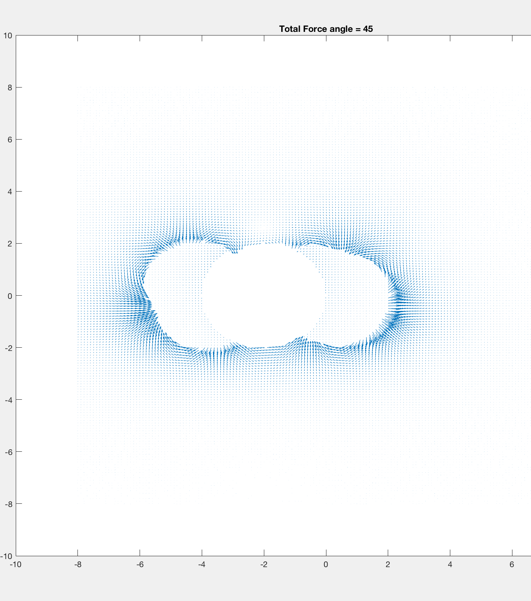
Vector map for force
Although it is a little bit hard to draw it out. I can feel there is a distortion in shape compared with zero angle because of the asymmetry of moving and fixed magnets.
(-1,4) points upwards
(-1,-4) points downwards
(-6,0) points to the right
(6,0) points to the right
(1,4) point upwards
(1,-4) point downwards
(-3.5,4) points upwards
(-3.5,-4) points downwards

Slide 8
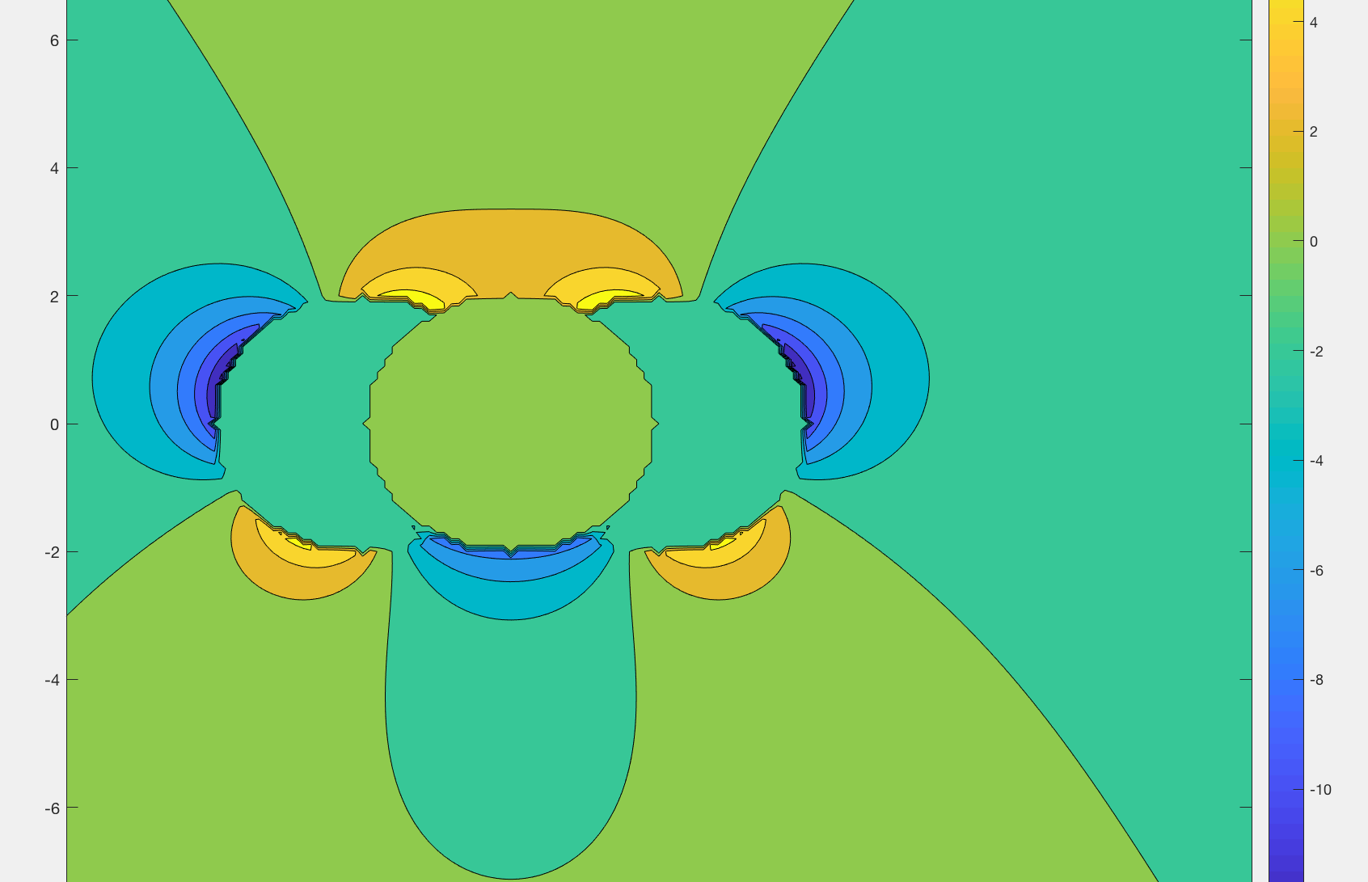
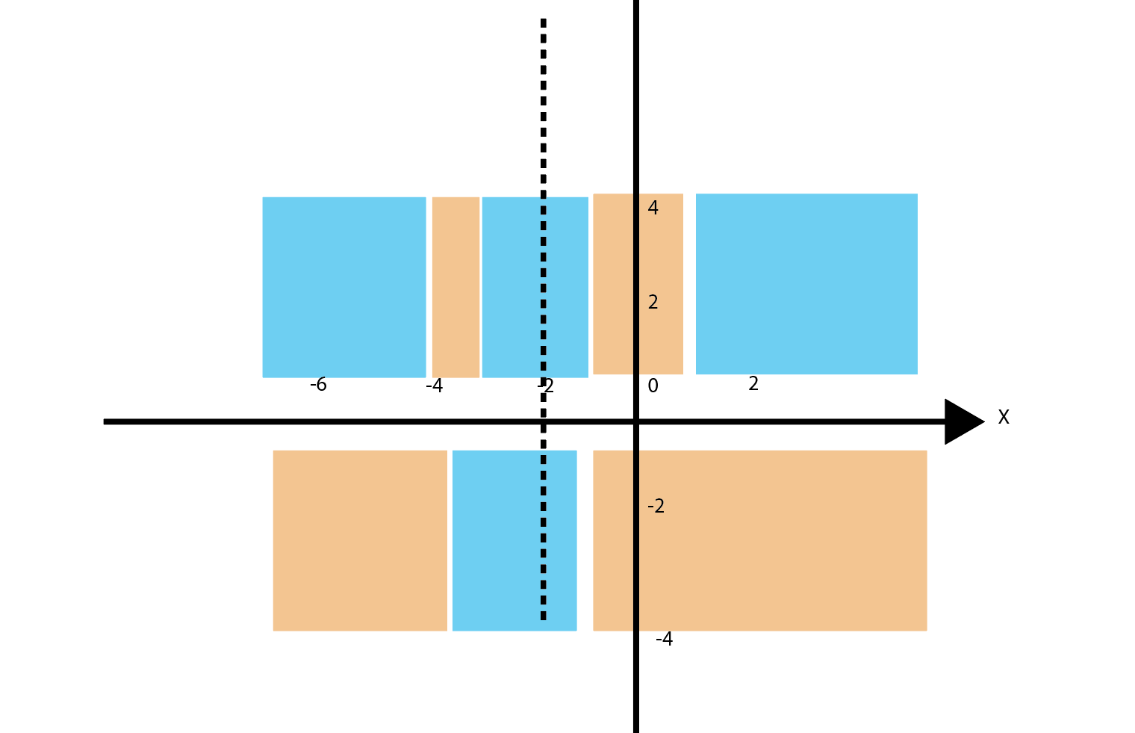
Torque graph
blue region and orange region represent the negative torque and positive torque respectively
The force is symmetric with x = -2(the center of moving magnets and fixed magnet is aligned), y = x and y = -x

Slide 9
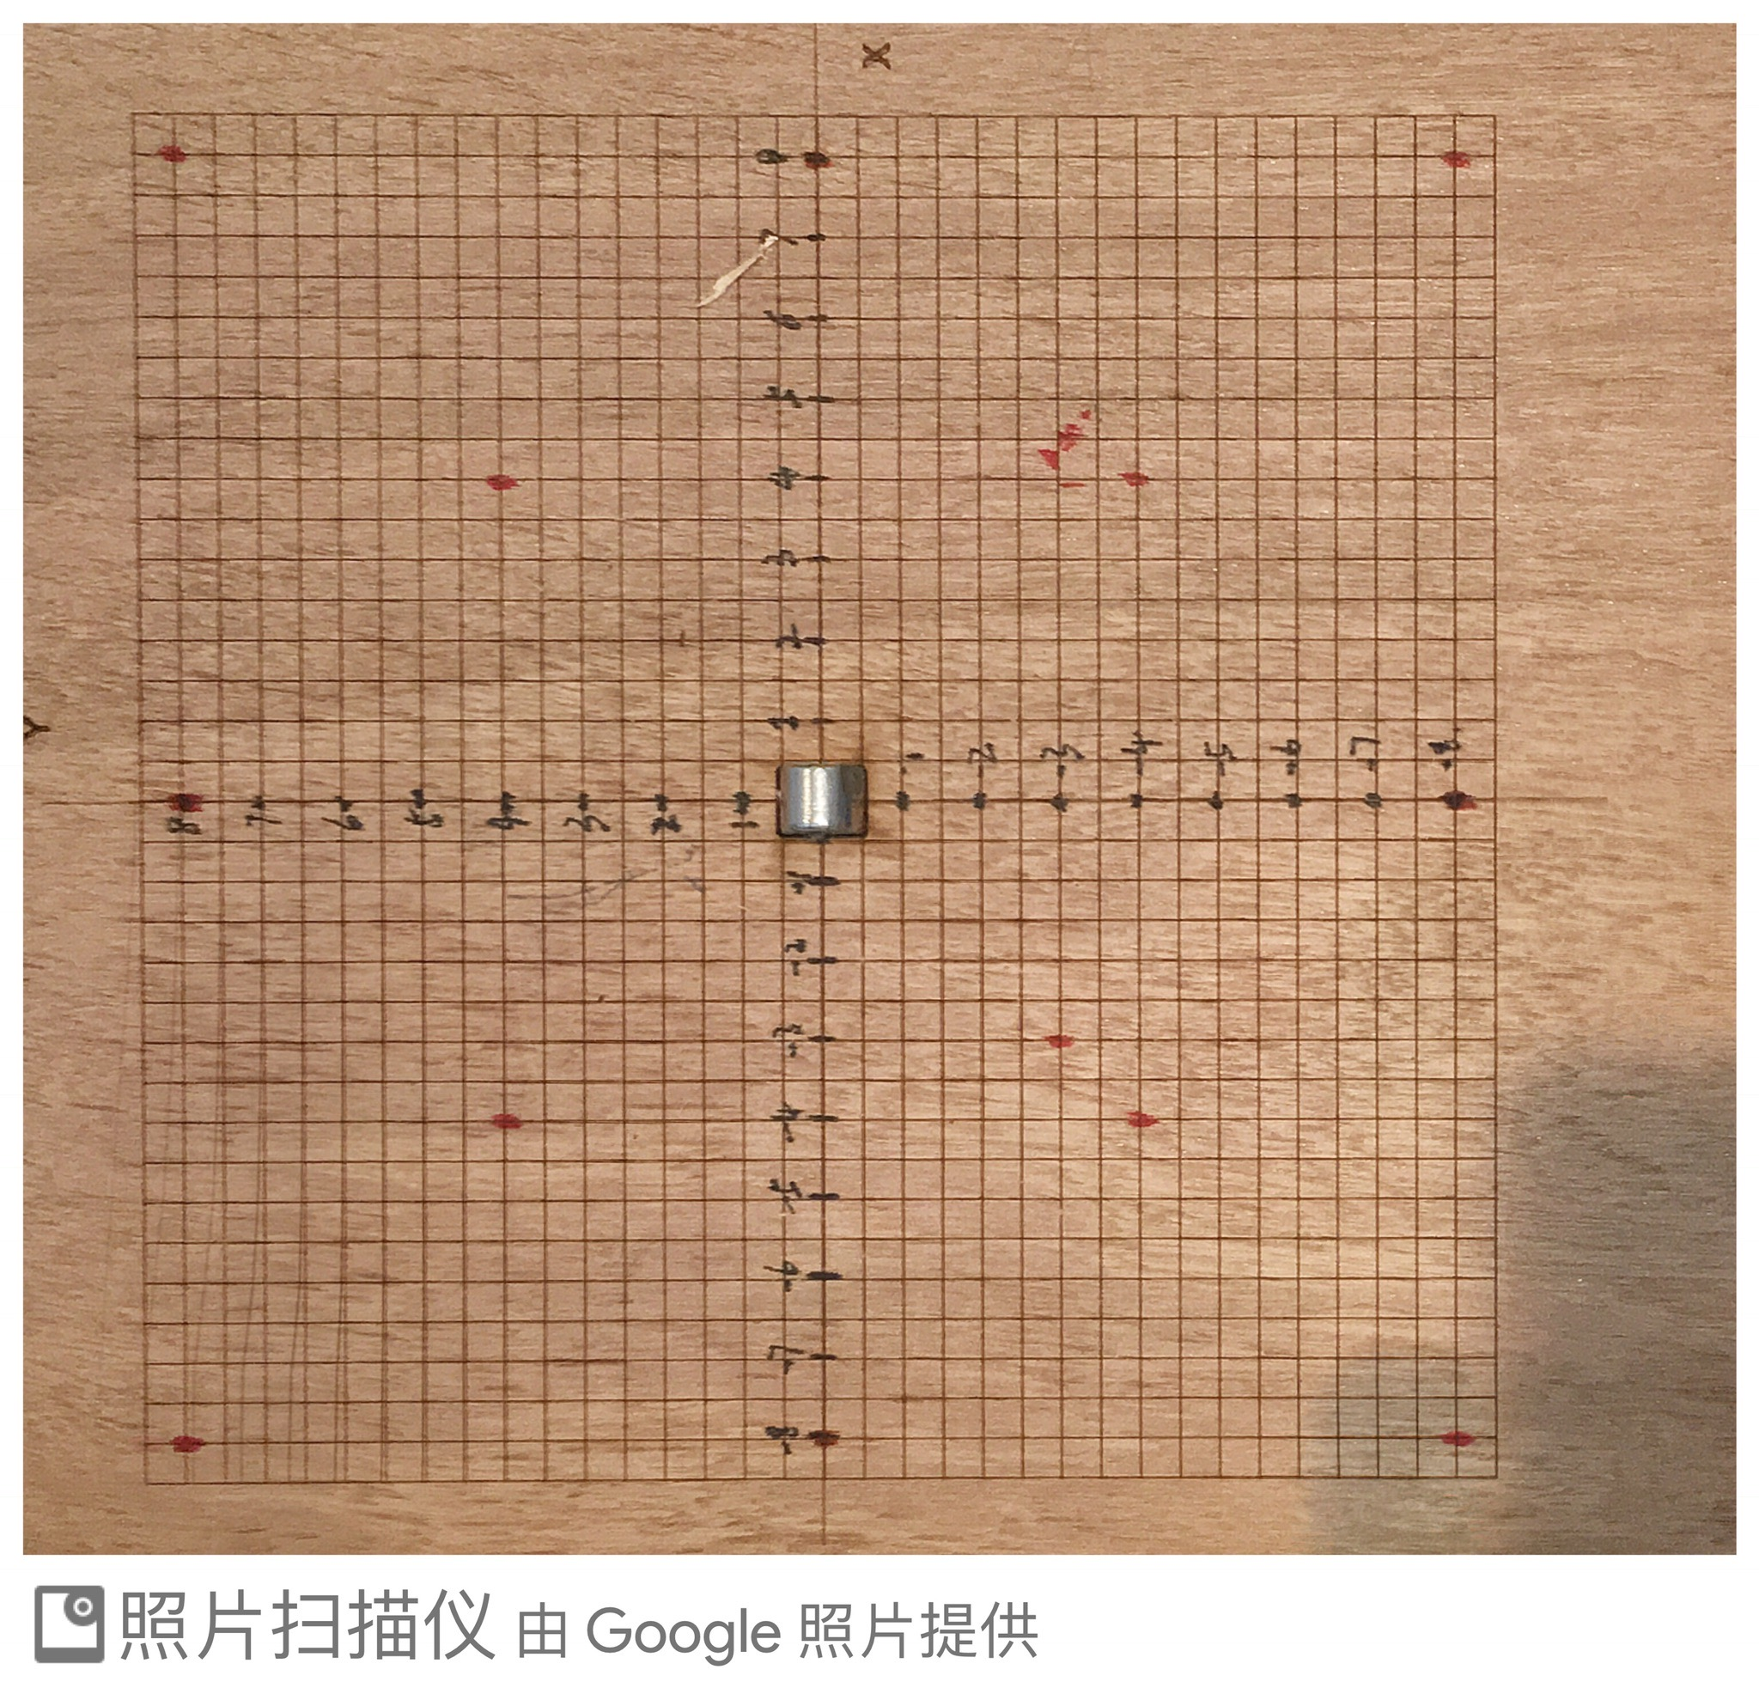
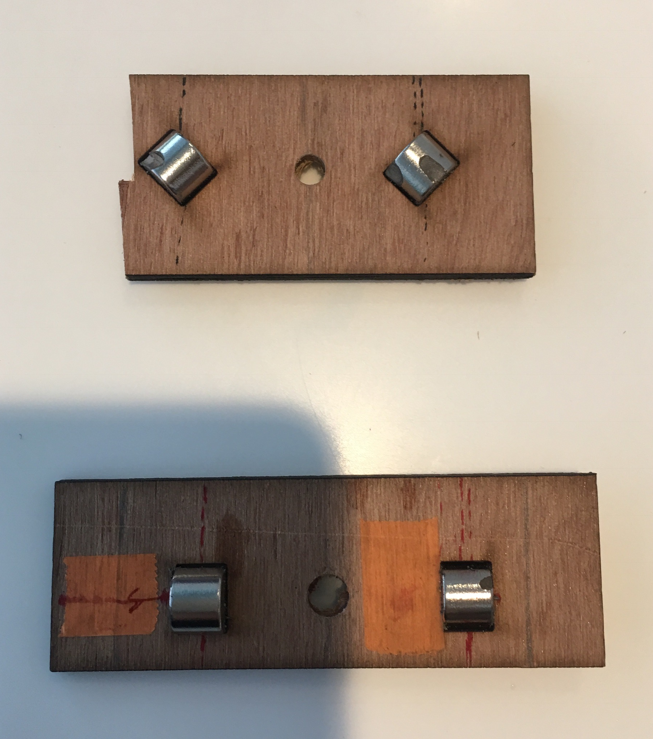
Experimental tool
a) 8cm*8cm wooden board with grid
b) A small piece of wood with two holes separating by 4cm from center to center.

